Slide 1
Forecasting Currency Exchange Trend
My Case Study is United States Dollar (USD) vs Canadian Dollar (CAD)
Master’s Thesis
By: Akubue Simon C
On: 01-Oct-2024

Slide 2
Motivation
Majority of the Forex traders lose their money due to inadequate knowledge on the dynamics of the market forces. 98% of the times, market forces is determined by the Macroeconomics news from the countries around the world.
Mitigating against this high rate of losses formed the basis of my research dream on “Forecasting Forex Exchange Trend”

Slide 3
Content
Pre-Amble
Data Sources
Statistical
Technical
Macroeconomics
Algorithms
Flow Diagram
Models Comparison
Visualization
Result
Recommended Model
Future Plans

Slide 4
Pre-Amble
The foreign exchange (forex) market stands as one of the most dynamic and influential financial markets globally, facilitating the exchange of currencies and shaping international trade and investment. Among the myriad currency pairs traded in this market, the USD/CAD pair occupies a significant position due to its prominence in North American trade and its influence on the economies of the United States and Canada.

Slide 5
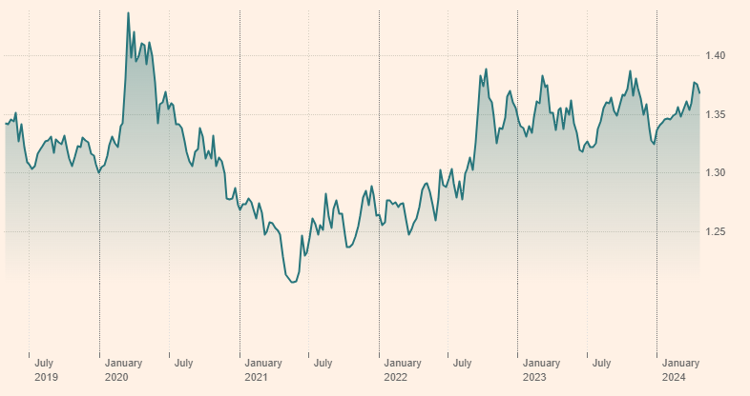
Last five years data on USD/CAD
https://markets.ft.com/data/currencies/tearsheet/summary?s=USDCAD

Slide 6
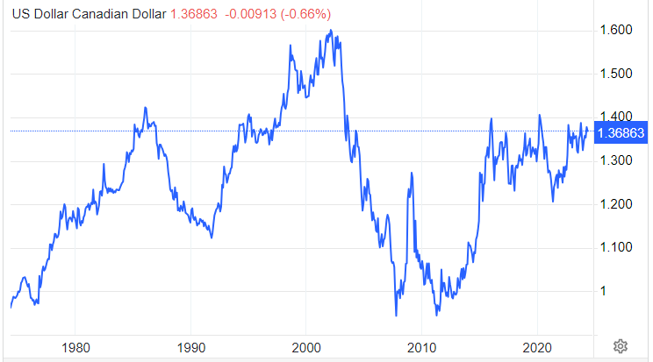
Last fifty years data on USD/CAD
https://tradingeconomics.com/canada/currency

Slide 7
Data Sources
World Bank
Macroeconomics data
Split
Train/Test
Evaluate
Forecast
Forex Market
DataFrame
Statistical data
Technical data

Slide 8
Data Source {Statistical}
My Data Set is taken from either of these two sources:
YFinance ➔ From year 2003 to Sep-2024 {with over 5,385 records}
(b) Investing.Com ➔ From 1982 to Sep-2024 {with over 11,000 records}
The data in either of these two cases is maintained on a daily bases.

Slide 9
Data Source {Macroeconomics}
The following Macroeconomics data played a strong role in my model. They were sourced from the World Bank’s(http://api.worldbank.org/) database through an API that was exposed as XMLs.
Consumer Price Index (CPI) of USA Consumer Price Index (CPI) of Canada
The Interest Rates of USA The Interest Rates of Canada
The Inflation Rates of USA The Inflation Rates of Canada
GDP Ratios of USA GDP Ratios of Canada
GDP Growths of USA GDP Growths of Canada
Imports of USA Imports of Canada
Exports of USA Exports of Canada
Government revenue of USA Government revenue of Canada
Un-Employment Rates of USA Un-Employment Rates of Canada

Slide 10
Data Source {Technical}
The following technical indicators were integrated:
RSI – Relative Strength Index
This is a momentum indicator that measures the magnitude of recent price changes to analyze overbought or oversold conditions
(b) SMA - Simple Moving Average
This is the average price over the specified period. It is calculated by adding up the last "X" period's closing prices and then dividing that number by of Xs

Slide 11
Data Source {…..Technical}
(c) EMA – Exponential Moving Average
This is a type of moving average that gives more weight to recent data points compared to older data points. It is calculated by applying a smoothing factor to the previous EMA value and the current price.
(d) MACD - Moving Average Convergence Divergence
This is a popular technical analysis indicator used to identify trend reversals and momentum changes in financial markets, including stocks, currencies, and commodities. It consists of three components: the MACD line, the signal line, and the histogram.

Slide 12
Algorithms
I am comparing many models like:
I am considered the following models for my forecasting:
XGBoost model
Lasso Regression model
Ridge Regression model
Linear Regression model
AdaBoost Regression model
Random Forest Regressor model
Bayesian Ridge Regression model
Support Vector Regression (SVR) model

Slide 13
Flow Diagram
Data Source 01
World Bank
Split the Data
Macroeconomics data
YFinance
Train the Model
Source
DataFrame
Evaluate the Model
Data Source 02
Investing.Com
Predict the Future

Slide 14
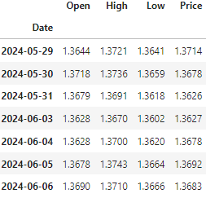
Statistical Data

Slide 15
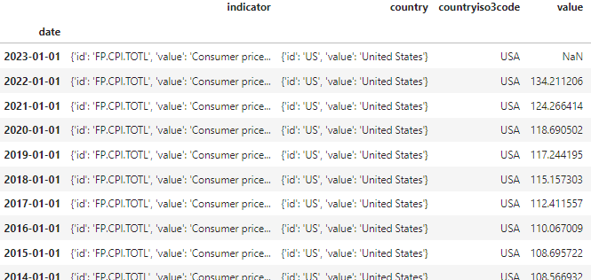
Macroeconomic Data
url = 'http://api.worldbank.org/v2/country/' + Cntry + '/indicator/FP.CPI.TOTL'

Slide 16
Macroeconomic Data
Years
Index Values
2022
134.211206
No of Business Days = 260
Diff = 9.944792
2021
124.266414
Incremental Value = Diff/No of Business Days

Slide 17
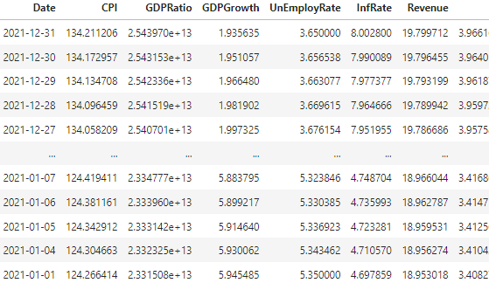
Macroeconomic Data

Slide 18
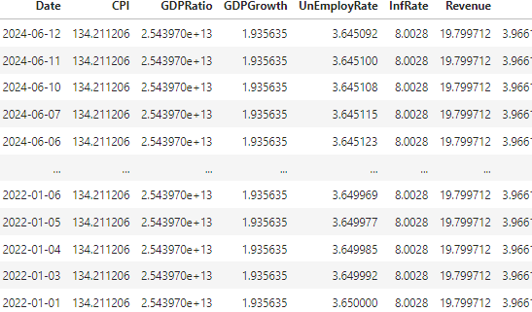
Macroeconomic Data

Slide 19
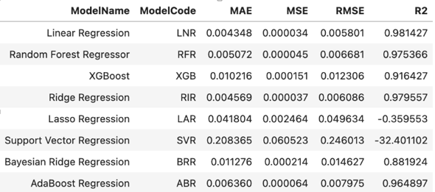
Models Comparison
85% Train – 15% Test Splitting

Slide 20
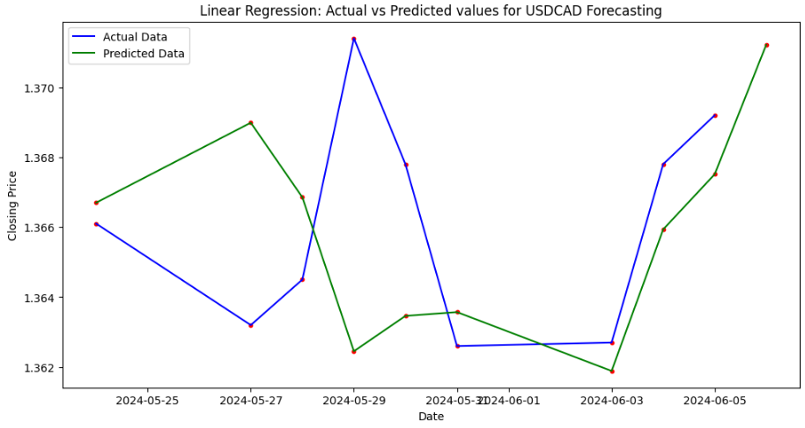
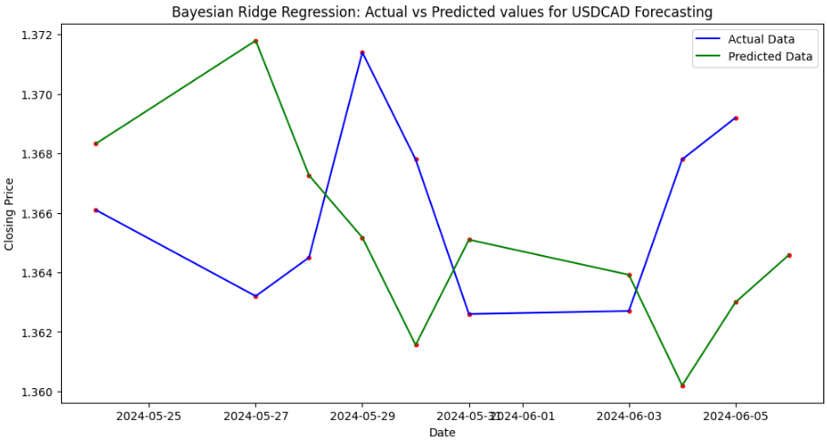
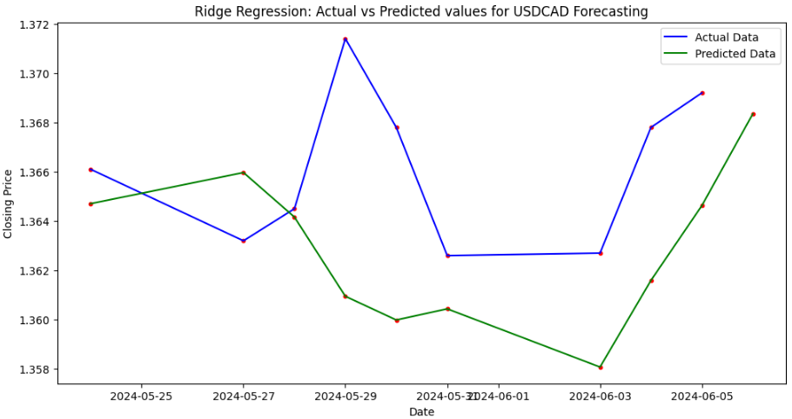
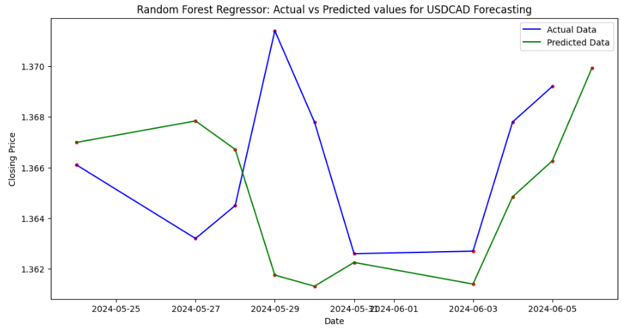
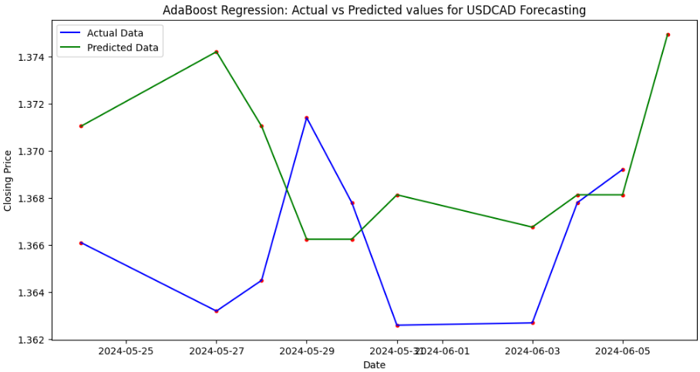
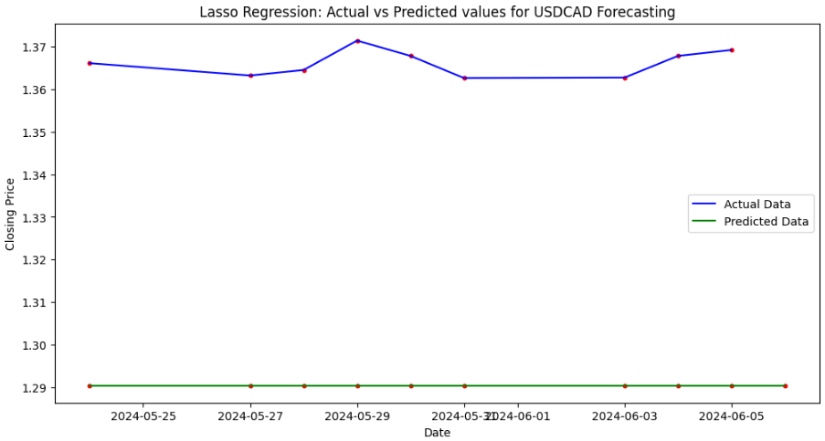
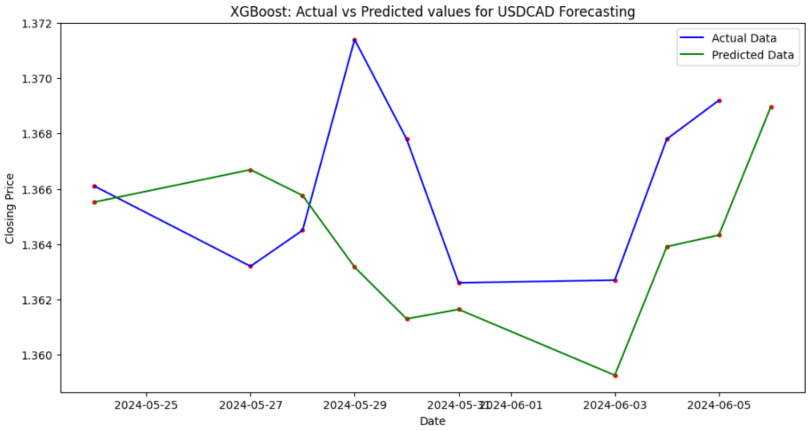
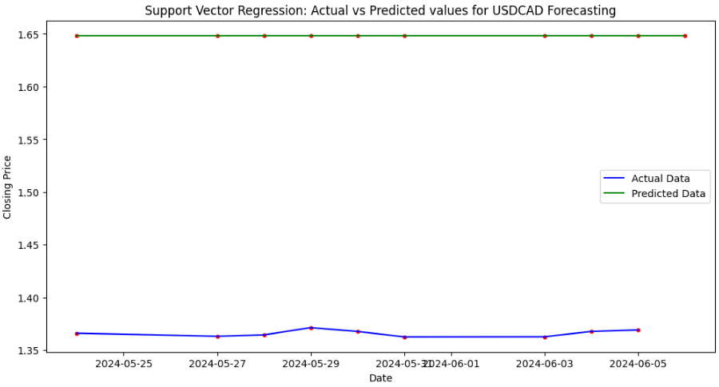
Visualization (85% - 15%)

Slide 21
Result
From the above analysis, on reviewing the MAE and MSE, and RMSE values from all the models considered, it is apparently clear that “Linear Regression”, “Random Forest Regressor (RFR)” and “Ridge Regression” displayed wonderful results. However, I will be relying more on “Random Forest Regressor (RFR)” due to its robustness about accepting as many features as I wish.
RFR model is exposed to un-exhaustible features. This makes is possible to incorporate lots of Indicators which of course is the bedrock of Technical (Non-Fundamental) analysis in predicting Forex trends.

Slide 22
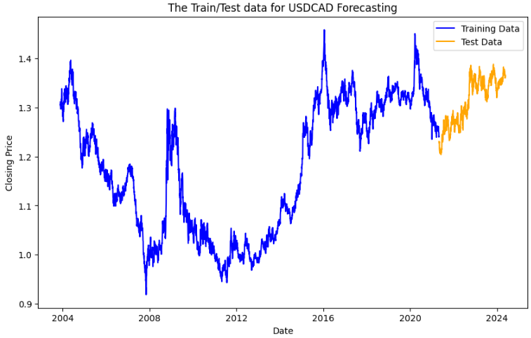
Raw data from YFinance

Slide 23
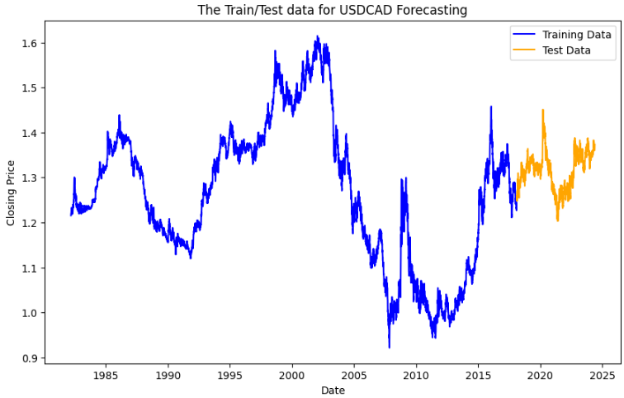
Raw data from Investing.Com

Slide 24
Random Forest Regressor (RFR)
Random Forest Regressor (RFR) is a supervised learning algorithm belonging to the ensemble learning family, specifically the random forest method, used for regression tasks. It's an extension of the Random Forest algorithm for classification.
Random Forest Regressor is known for its robustness, scalability, and ability to handle high-dimensional data with a large number of features. It often performs well across a wide range of regression problems and is less prone to overfitting compared to individual decision trees.

Slide 25
…Flexibility and Robustness of RFR
This model offered me the opportunity of adding as many features as I can in order to improve on my Predictions.
Here I employed the standard indicators like:
RSI (Relative Strength Index)
SMA (Simple Moving Average)
EMA (Exponential Moving Average)
MACD (Moving Average Convergence/Divergence)
I can add as many more indicators in order to strengthen the quality of my predictions.

Slide 26
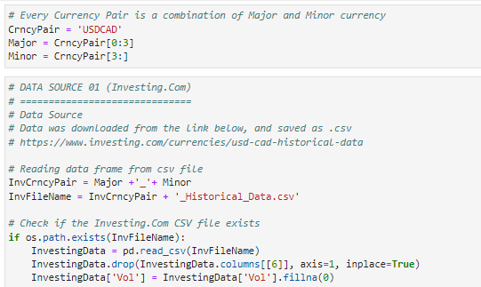
My Codes (Interesting Parts)

Slide 27
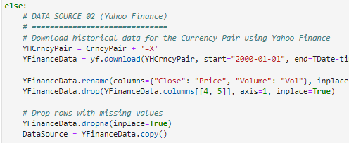
My Codes (Interesting Parts)

Slide 28
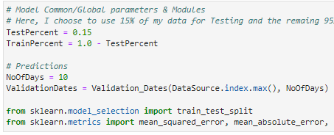
My Codes (Interesting Parts)

Slide 29
Future Plans
I will also explore alternative source where I can access the Macroeconomics indices maintained at bi-Annual, Quarterly, or Monthly levels.
I plan to improve on my model by adding more Statistical and Technical features.
I will explore a way of automatically accessing the Statistical data from a source like Tick Data Suite(TDS) whose data is as close as the live data.

Slide 30
Thank you

